Slide 1
CattleSavior: Towards Implementing an Advanced External Disease Detection System through Deep Learning
Members:
Rantu Das (20301343)
Yousuf Sinha (20301432)
Sohidul Haque Sahid (20301403)
Dipta Dipayan Kar (20301414)
Shahidul Haque Shaheen (19201033)
Supervisor:
Jannatun Noor Mukta
Assistant Professor
Department of CSE
Brac University
Co-supervisor:
Rafeed Rahman
Lecturer
Department of CSE
Brac University
Department of Computer Science and Engineering
School of Data and Sciences
Brac University
21 September, 2023

Slide 2

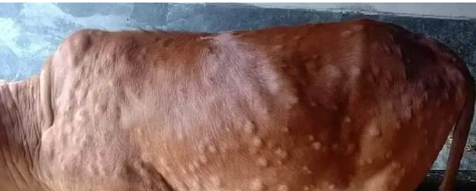
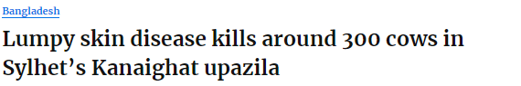

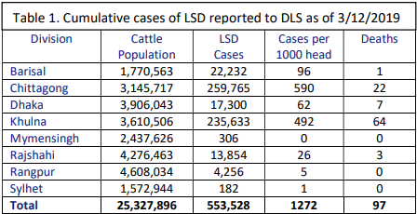
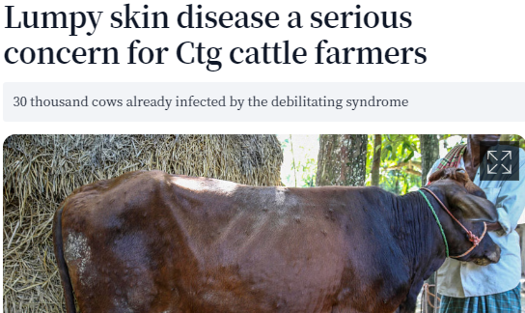
Background
1

Slide 3
Importance of livestock
Contribution in youth Entrepreneurship.
2.9% of national GDP is covered [1].
About 20% of people earn their livelihood [1].
Helping in domestic production of milk and meat.
83.9% of total household owns livestock and currently, total number of cattle is about 25.7 million [1].
2

Slide 4
Research Objective
Detecting common external diseases with real-time solution.
Conducting a survey on cattle farmers to identify common diseases.
Building a deep learning model for disease detection.
Developing a mobile application to incorporate the model.
Installing the App into cattle farmer’s phone.
Conducting a feedback survey.
3

Slide 5
Research Contribution
Conducting an survey on (N=26) cattle owners and find out 3 of the most common external diseases.
Collecting the dataset & exploring different CNN models.
Proposing a new CNN model with less parameters.
Developing the ‘CattleSavior’ mobile App which can accurately detect 3 diseases with 6 other necessary features.
Collecting cattle farmers’ feedback (N=11) by another survey.
4

Slide 6
Related Work
Machine Learning (ML) and Deep learning (DL) aspect
Disease | Models used | Accuracy | Data Collection
Lumpy | ANN, KNN, LR, NB, SVM, DT, RF, Gaussian Naive Bayes,SGD, LGBM, GB, Adaboost, XGB, Inception-v3, VGG-16, VGG-19, | 92.5%,97%, 98% | Mendeley,Kaggle, Self-collection
Bovine mastitis | SVM, Random forest | 81% | Kaggle,Self-collection(Using EID device)
Foot and Mouth | Artificial Neural Network, CNN- AlexNet, GoogleNet, ResNet, VGC-16 | 91%,94%,95% | Self-collection
5

Slide 7
Related works in HCI aspect
N.B: At the best of our knowledge from these researches there is no such work that can detect diseases & give feedback based on the detected disease.
APP Name | Features | Models used | Accuracy
Android app (Author: Shivaanivarsha et al) [5] | Detects 4 types of bovine disease | CNN, TensorFlow Lite | 98.5%
Jaguza Livestock App (Author:Katamba et al) [6] | Features
 | Disease detection, Real-time animal tracking, Animal disease diagnosis, Veterinary doctor information, and Weather updates
6

Slide 8

Survey Data Collection
7

Slide 9
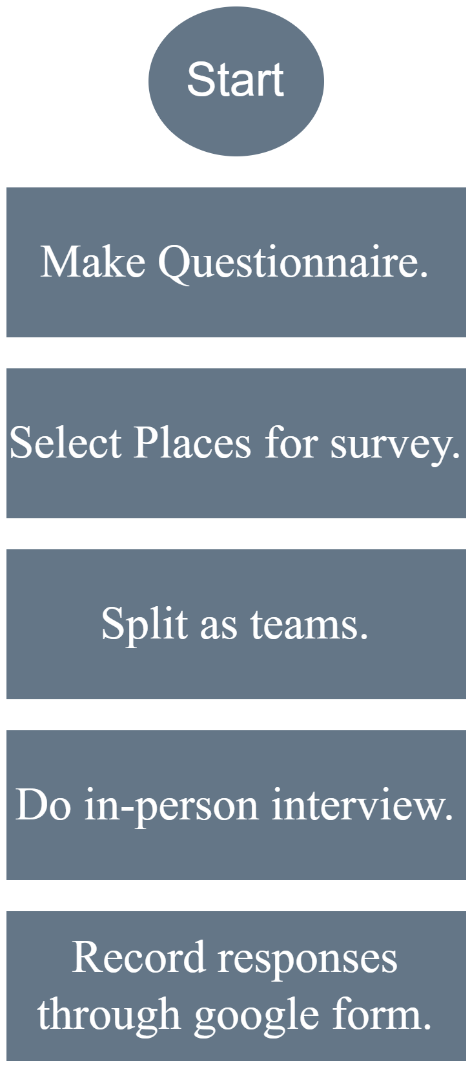
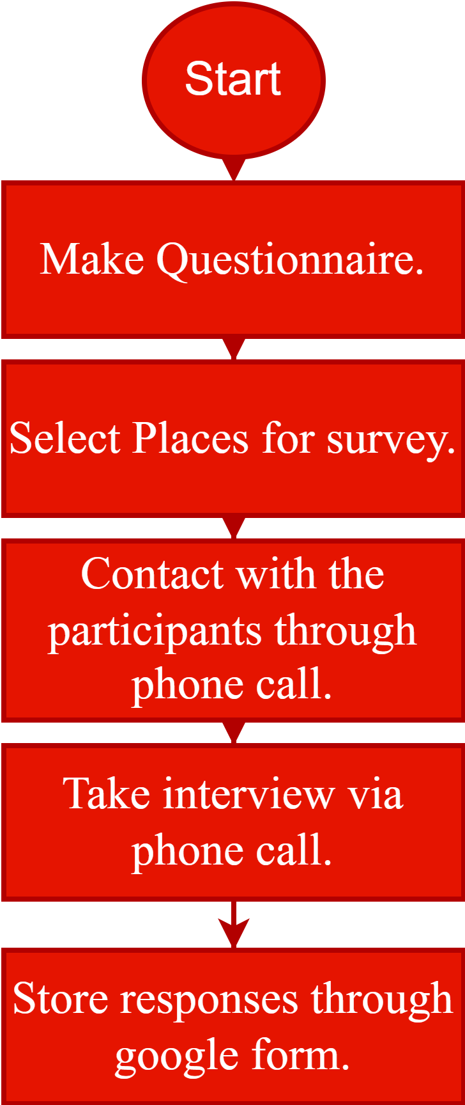
Survey Plan
Offline Online
Make a questionnaire.
Select survey conduction area.
Two types of survey:
i) Offline survey.
ii) Online survey.
Analyze all the responses.
8

Slide 10
Questionnaire Design
open-ended question.
Total 26 questions.
Questions were in English language.
Used 'Likert' scaling technique.
14
1
25
25
6
closed-ended question.
1
Likert scale questions
Qualitative questions
Multiple choice questions
Quantitative questions
9

Slide 11
Survey Conduction Infographics
Area
>> Bishmile
>> Pandhoa
>> Kamarpara
>> Bhatulia
>> Bamnartek
>> Brahmanbaria (13)
Savar (5)
Uttara(8)
50%
50%
Offline survey conduction.
Online survey conduction.
100%
Offline Survey
Online Survey
50%
In-person interview
Survey conducted via phone call
10
0%

Slide 12
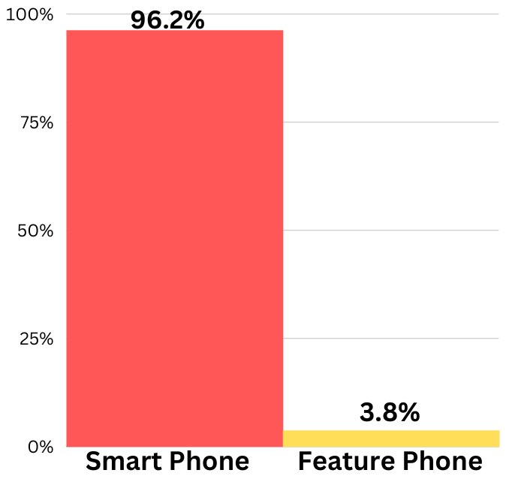
Survey Findings
The percentage of smartphone users among cattle farmers.
96.2% of them use smartphone as their primary device.
11

Slide 13
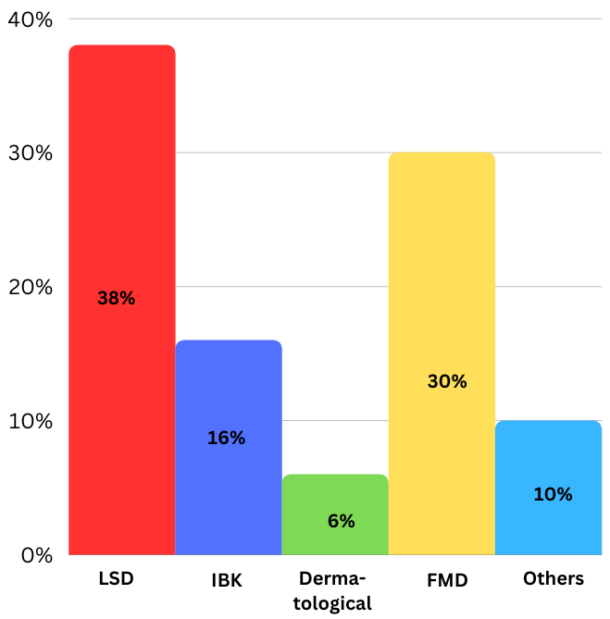
Survey Findings
We also want to know about the most common external diseases in farms.
Cattle affected by LSD 38%, FMD 30%,IBK 16% times.
12

Slide 14
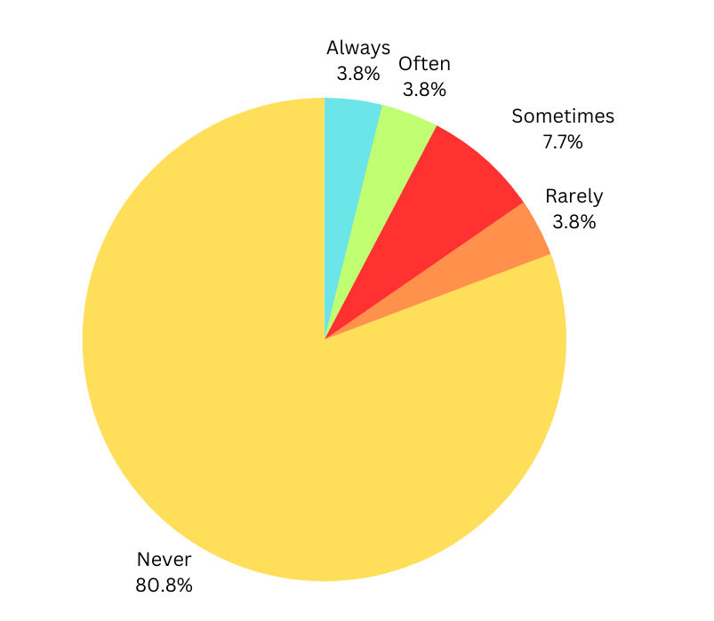
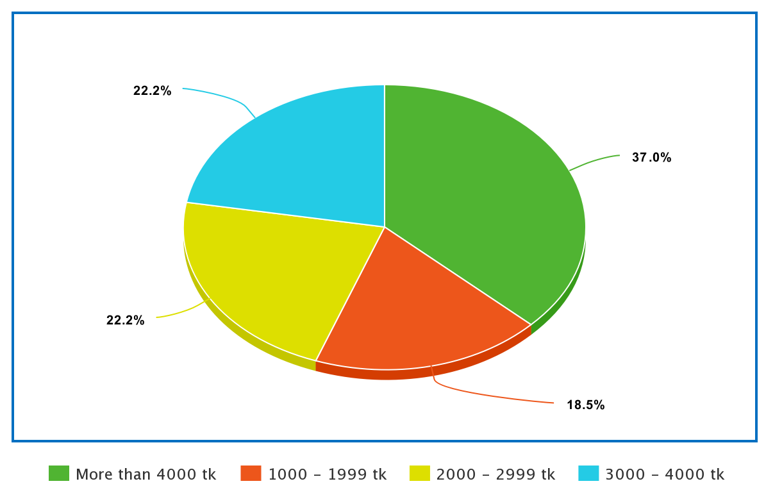
Survey Findings
Also asked about the usage of smartphones and about the costing for treatment of cattle for diseases.
80% time don't use smartphone.
37% farmer spend more
than 4000 BDT.
More than 4000 TK
1000-1999 TK
2000-2999 TK
3000-4000 TK
13

Slide 15
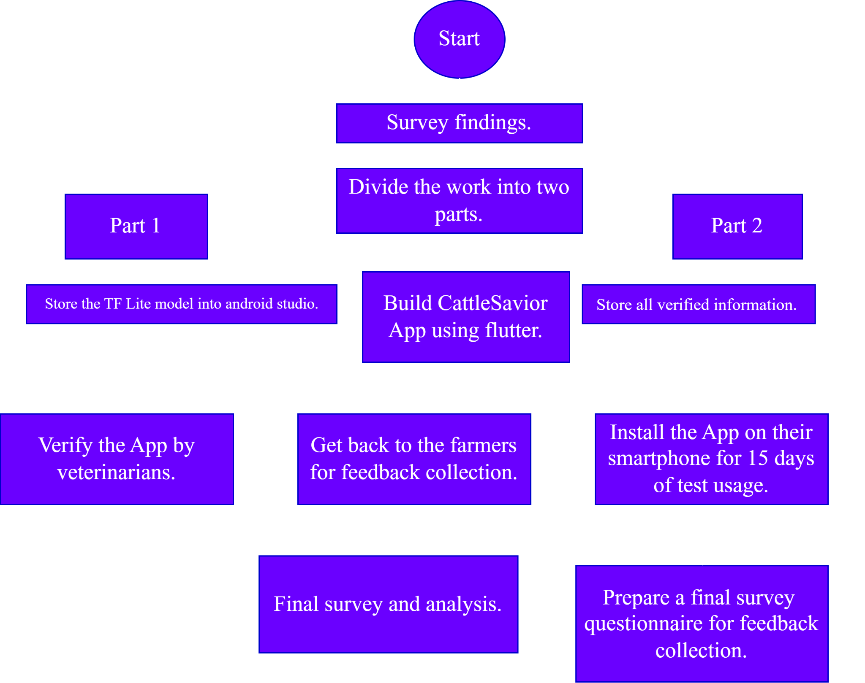
Plannings
14

Slide 16
Dataset Collection
 | Lumpy Skin Disease | Foot and Mouth Disease | IBK
Classes and Entities | LSD: 324 Normal: 700 Total: 1024 | FMD: 156 Normal: 148 Total: 304 | IBK: 150
Source | Mendeley Dataset | Zenodo Open Access Dataset | A research team from Daffodil University
Collected 150 images of Normal EYE
15

Slide 17
Final Dataset after Data Augmentation
Class Name | Number of Raw Image | Image numbers after Pre-processing
FMD | 156 | 2340
IBK | 150 | 1978
LSD | 324 | 2149
Normal Skin | 998 | 7325
Total | 1608 | 13792
16

Slide 18
Data Split
70%
20%
10%
Train
Validation
Test
17

Slide 19
Model Implementation
Proposed CNN Model
CattleNet
Related CNN Models
VGG-16
Inception-ResNet-v2
DenseNet-121
Inception-v3
Xception
18

Slide 20
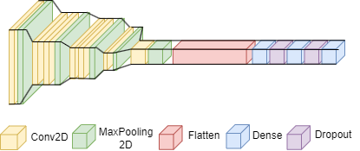
Structure of Custom CNN Model
Total Parameters - 7747,332
Dropout between dense layers- 20%
19

Slide 21
Comparative Analysis (Parameters, Accuracy and Loss)
Models | Parameters (in Millions) | Training Accuracy
VGG-16 | 15.11 | 0.96
Inception-ResNet-v2 | 55.26 | 0.99
DenseNet-121 | 7.69 | 0.98
Inception-v3 | 22.98 | 0.98
Xception | 22.11 | 0.98
Ours | 0.75 | 0.99
Training Loss | Validation Accuracy | Validation Loss
0.09 | 0.94 | 0.09
0.02 | 0.97 | 0.08
0.06 | 0.99 | 0.03
0.06 | 0.99 | 0.05
0.06 | 0.98 | 0.06
0.04 | 0.99 | 0.04
20

Slide 22
Comparative Analysis (Precision, Recall and F1-Score)
Models | Precision | Recall
VGG-16 | 0.95 | 0.92
Inception-ResNet-v2 | 0.99 | 0.96
DenseNet-121 | 0.99 | 0.99
Inception-v3 | 0.99 | 0.98
Xception | 0.98 | 0.97
Ours | 0.99 | 0.99
F1-score
0.93
0.97
0.99
0.99
0.98
0.99
21

Slide 23
Performance Metrics Comparison with Related Work
Authors | Methods | Detectable Classes
Genemo et al. [2] | ELM | LSD, Normal Skin
Rony et al. [3] | GoogleNet | FMD, Normal Skin
Rony et al. [4] | Inception-v3 | LSD, FMD, IBK
Ours | CattleNet(Proposed) | LSD, FMD, IBK, Normal Skin
22

Slide 24
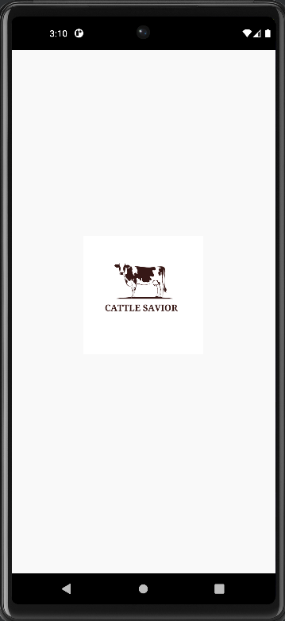
CattleSavior Mobile Application
23

Slide 25
All steps of app design and implementation
Step 1
Step 2
Step 3
Step 4
Import the TFLite model in Android Studio
Build the CattleSavior app using Flutter
Collect information regarding Feedback and other features from Veterinarians
Convert the TF model into the TFLite model
24

Slide 26
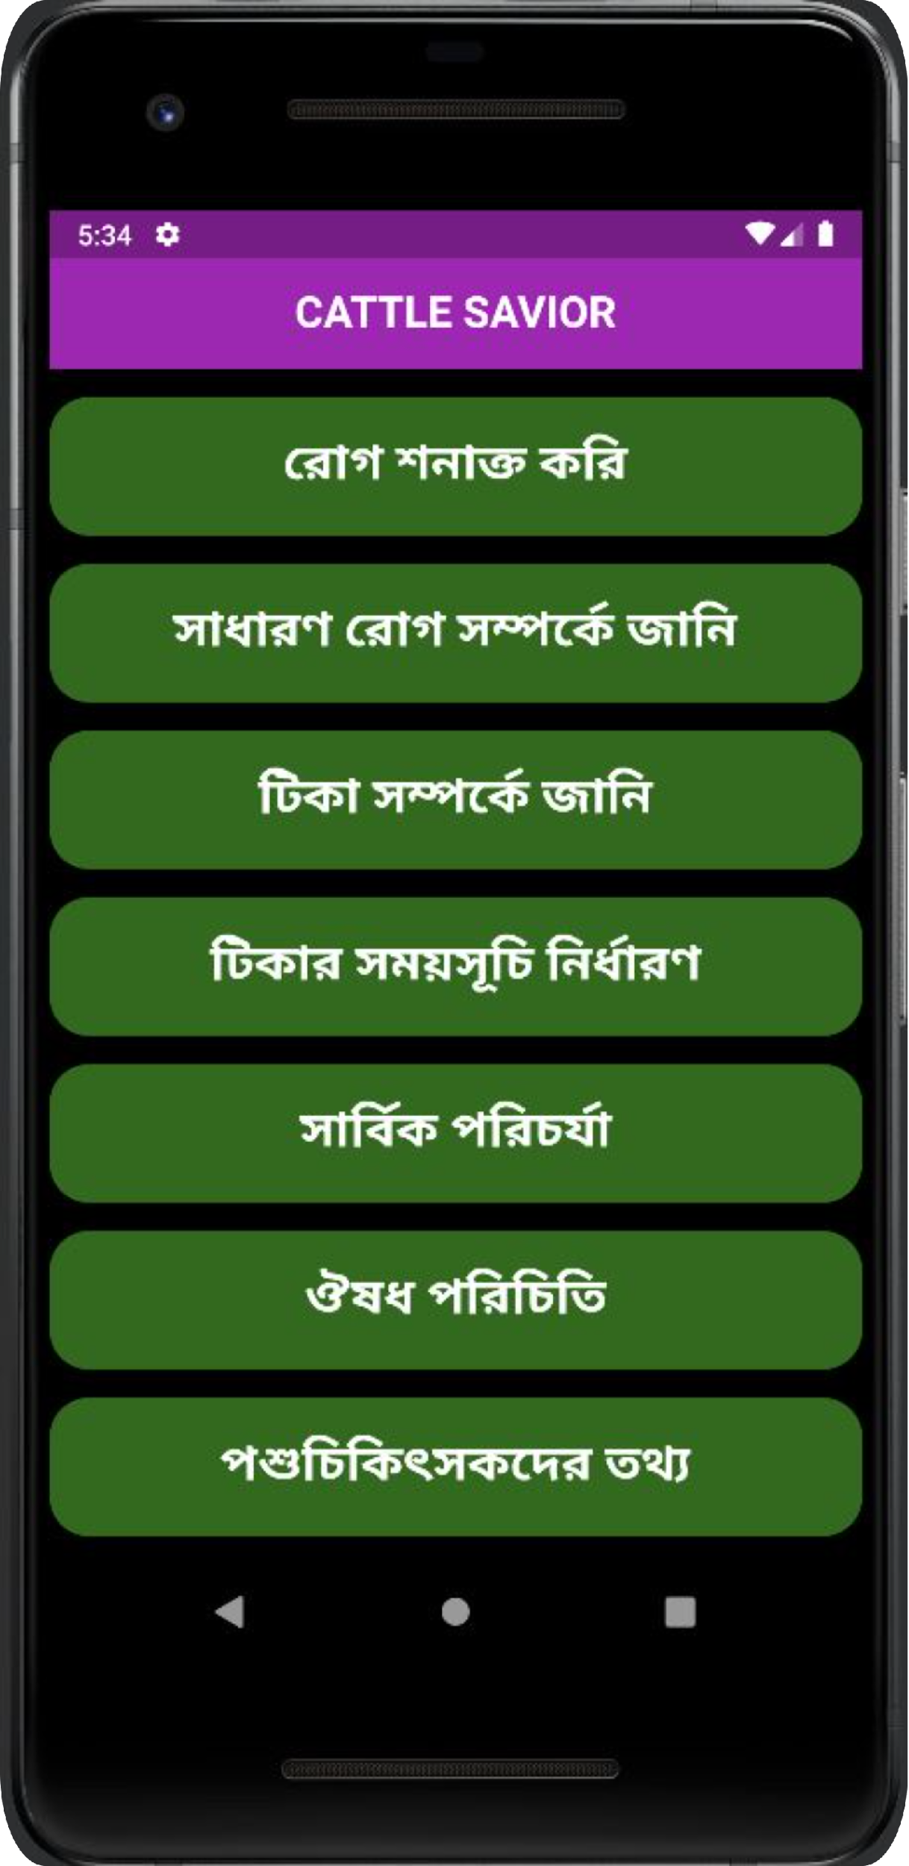
All Features of CattleSavior
Disease Detection and Instant Feedback
Information of General Diseases
Information about Vaccines for Various Diseases
Vaccination Reminder
Cattle Grooming Guideline
Generalization of Cattle Medicine
Veterinary Information
25

Slide 27
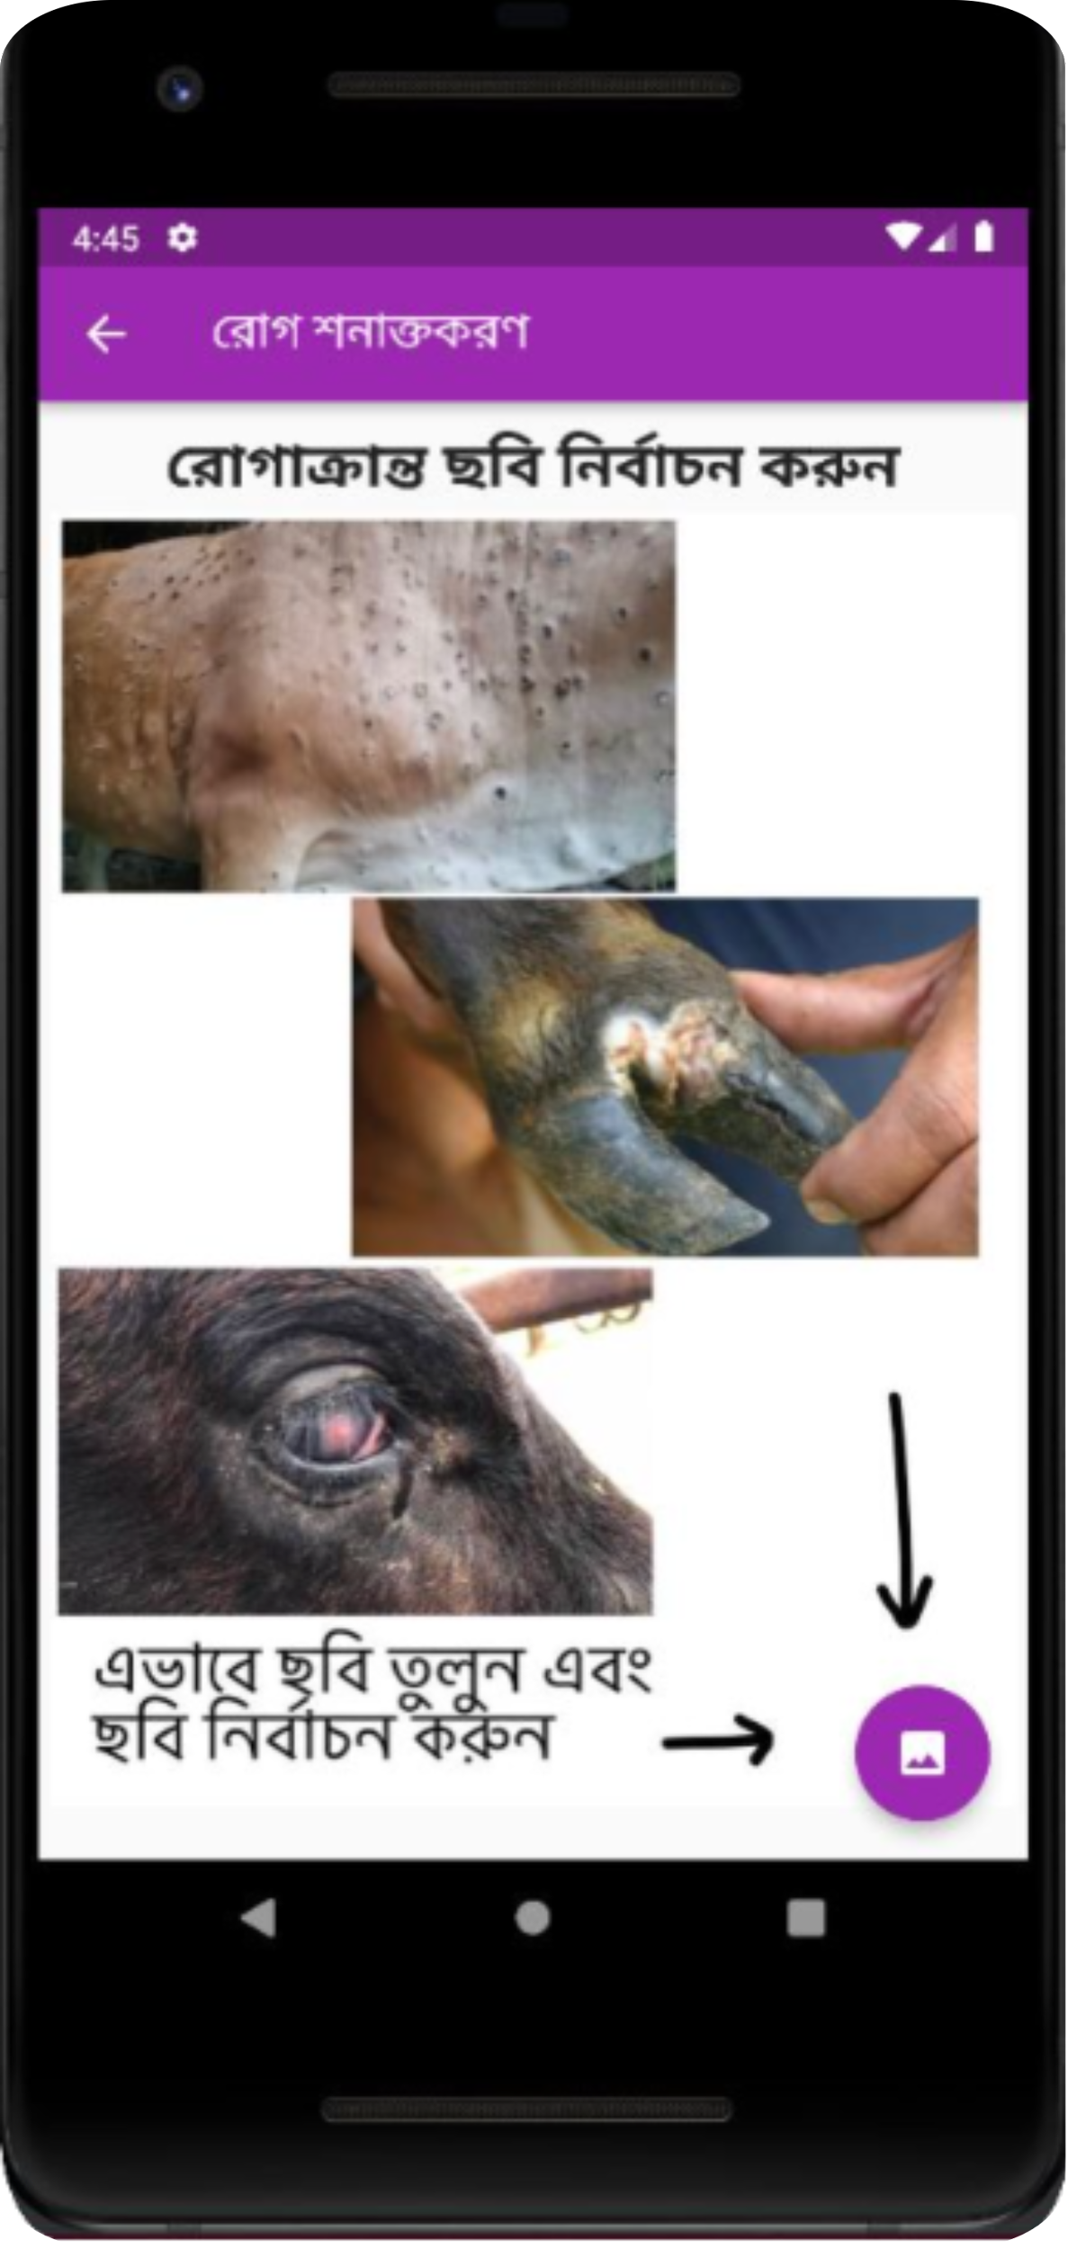
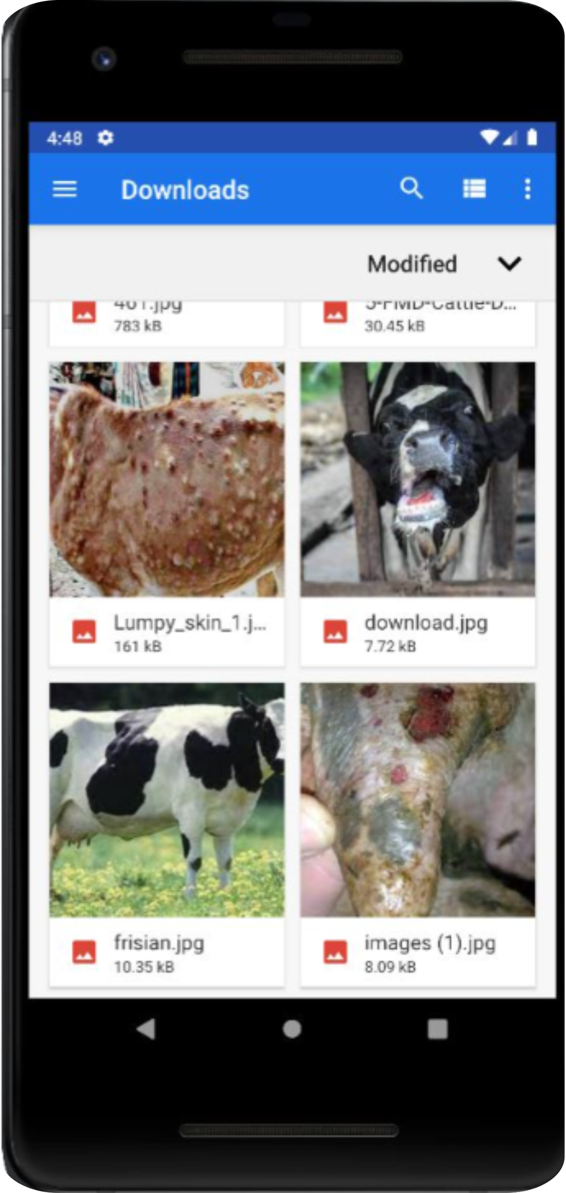
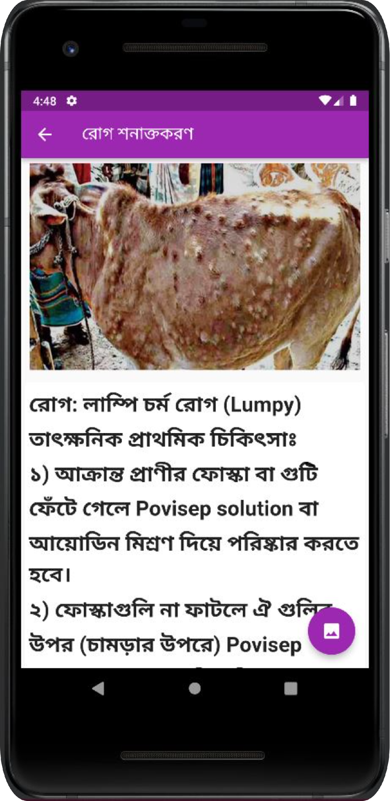
Disease Detection and Instant Feedback
Detect external disease and get instant feedback in just simple 3 steps.
26
Step 11
Step 2
Step 3

Slide 28
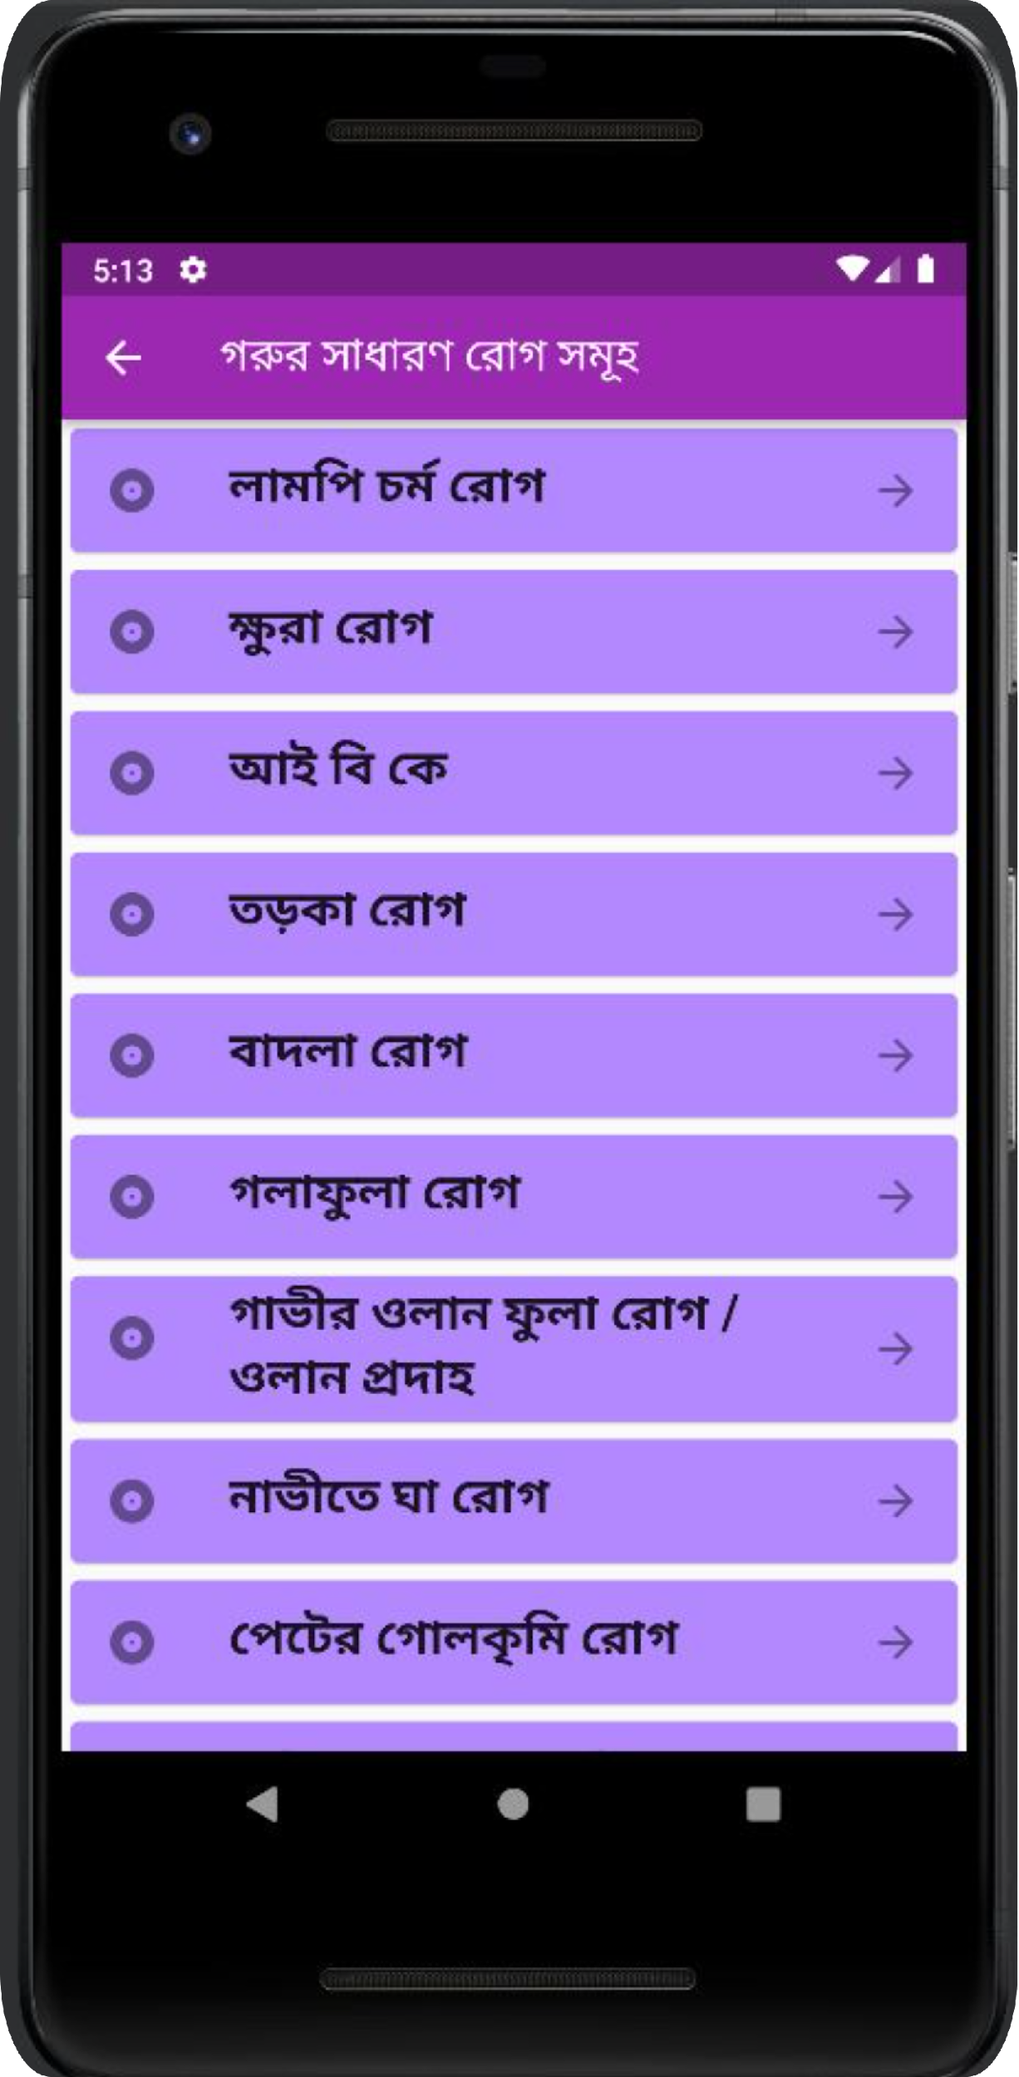
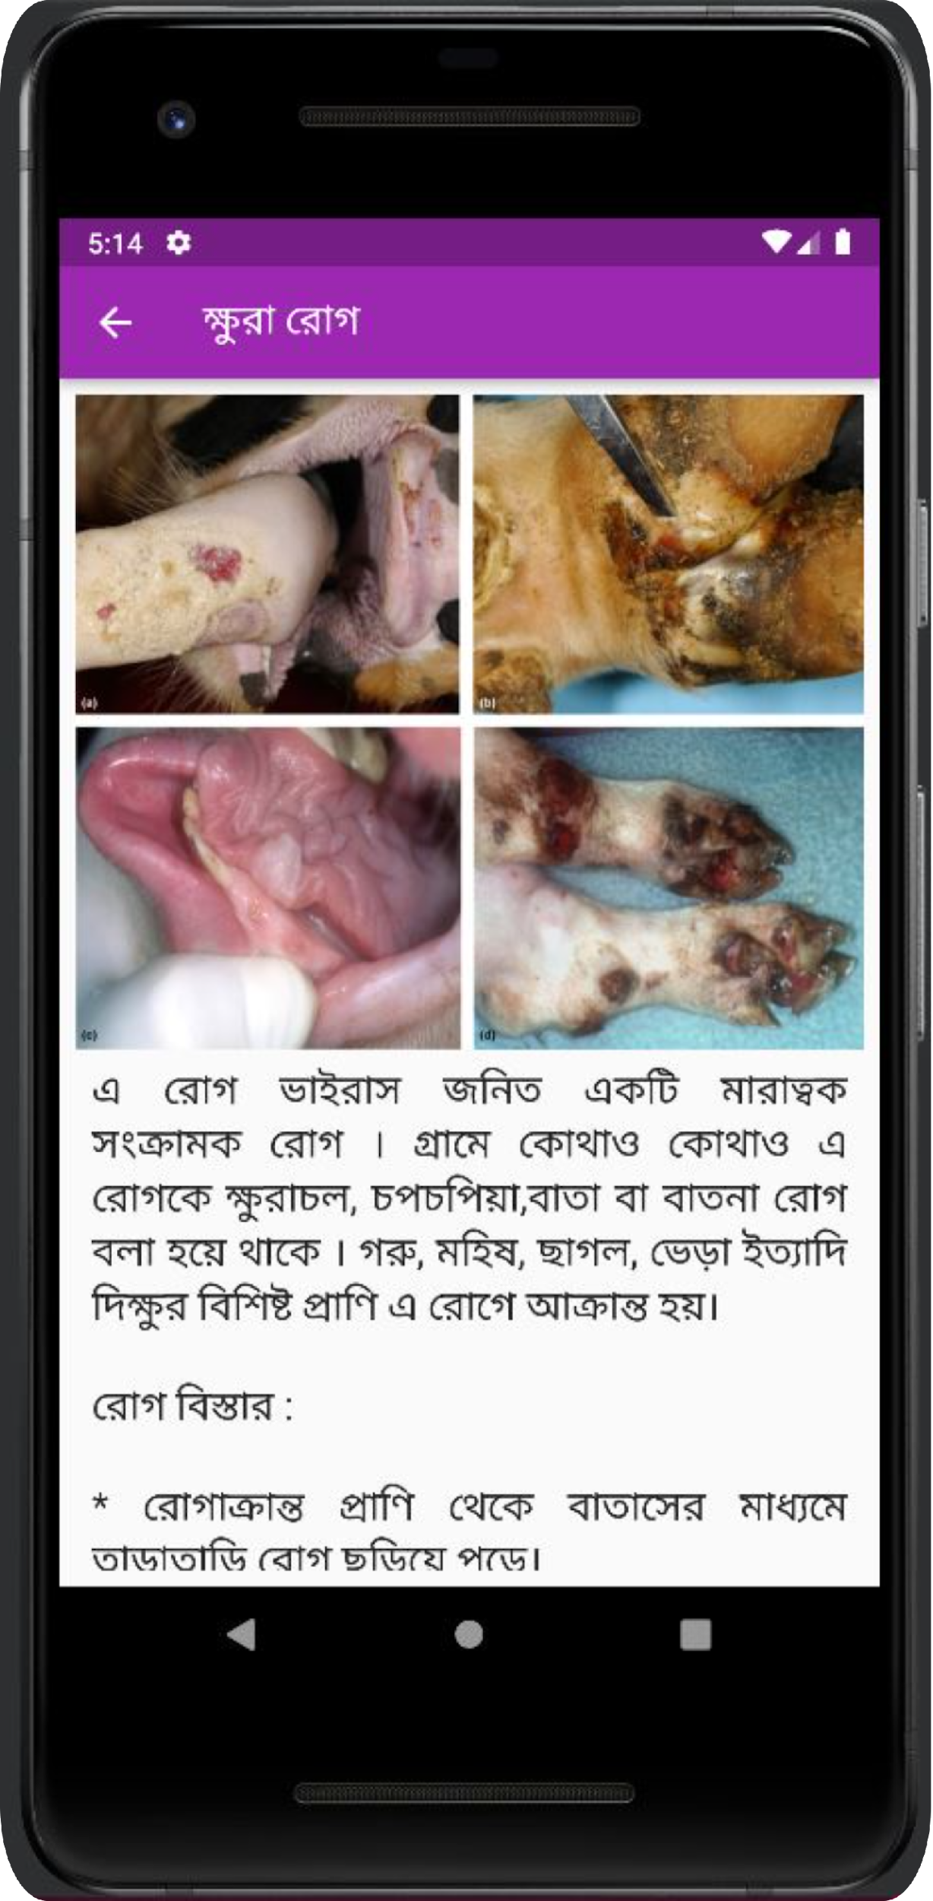
Information of General Diseases
Get to know about the common diseases (15 common external diseases).
Prepare beforehand and act accordingly to minimize the consequences
27

Slide 29
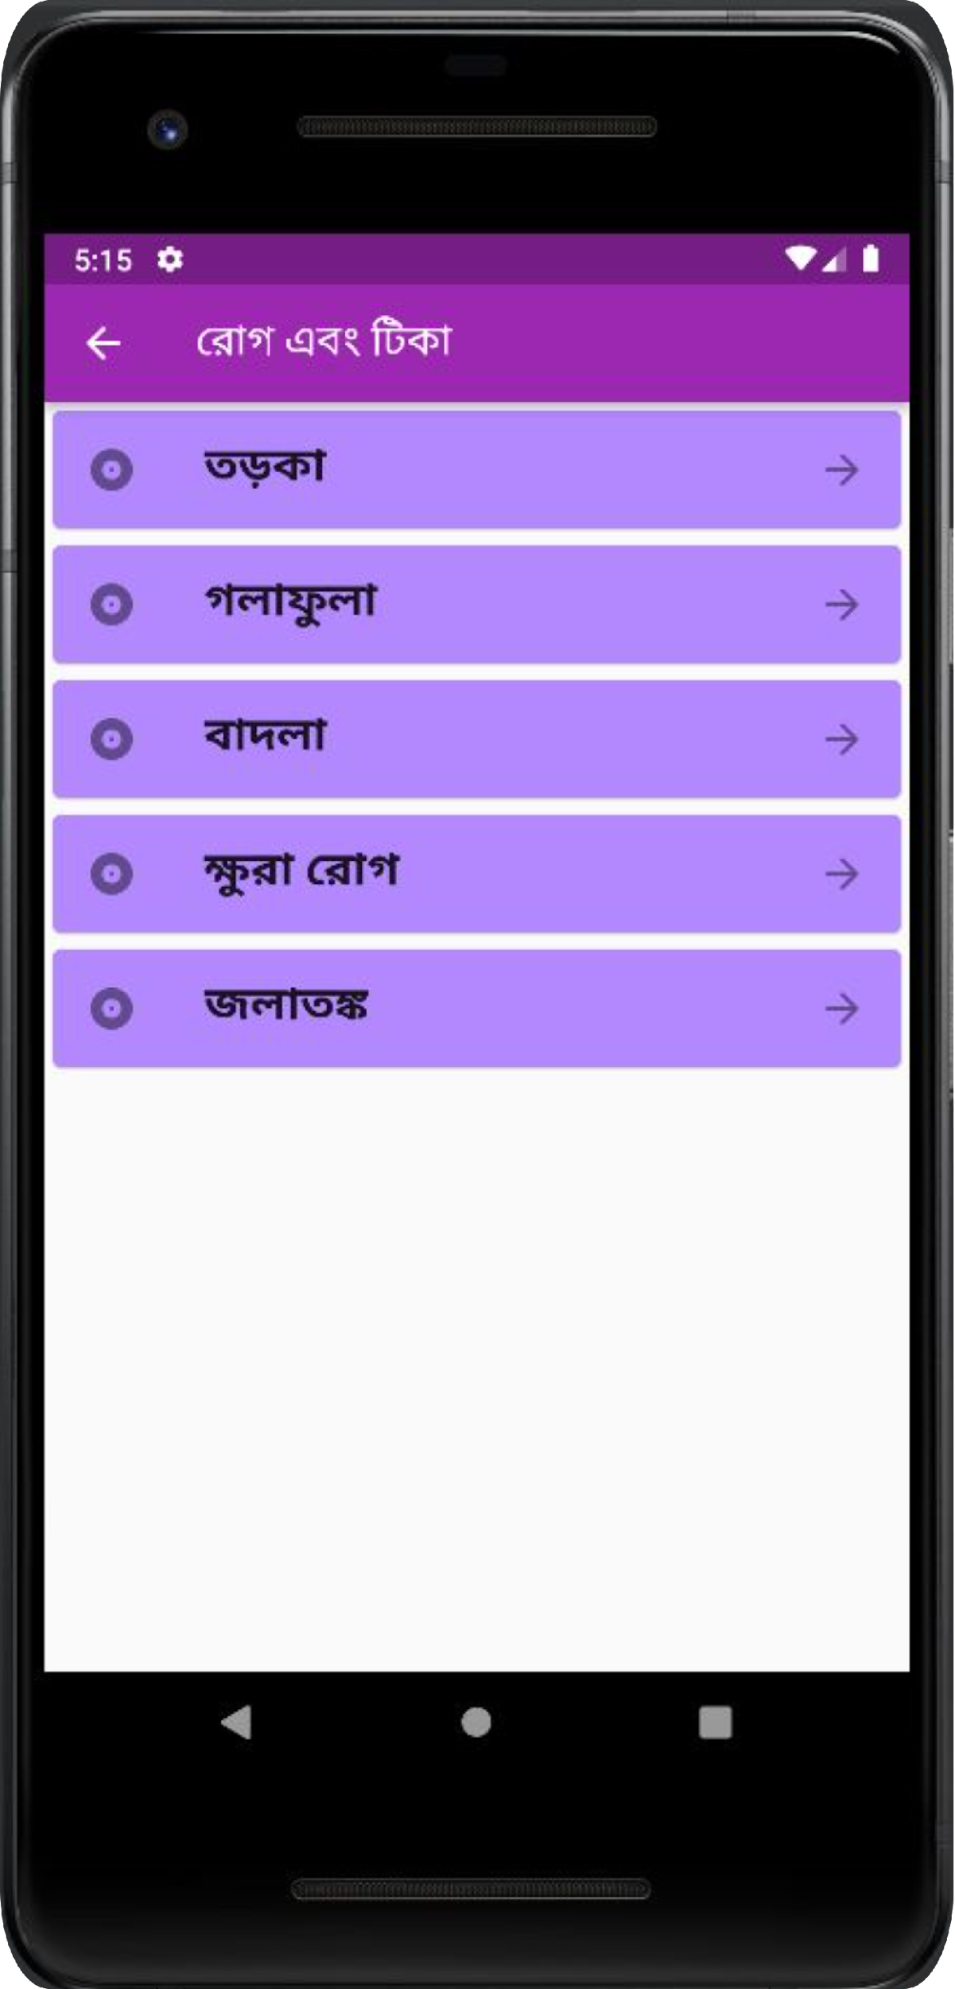
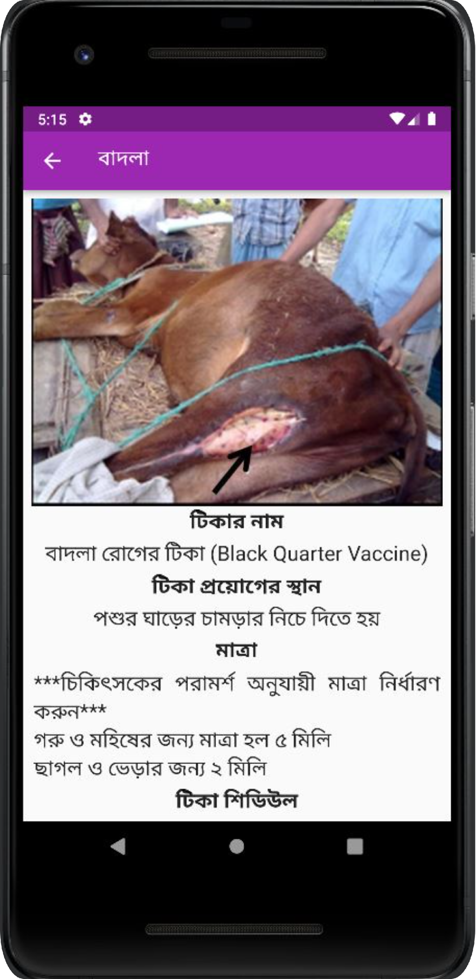
Information about Vaccines
The area of vaccination
The amount of dose
Vaccination schedule
Get a general idea about different vaccines
28

Slide 30
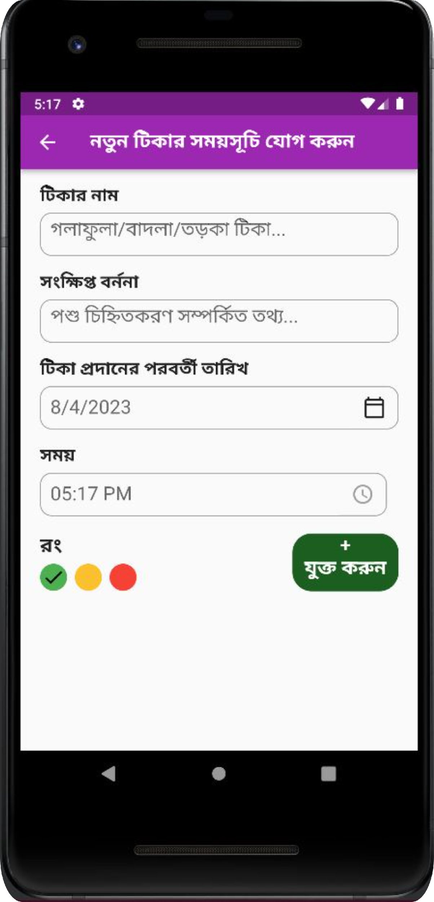
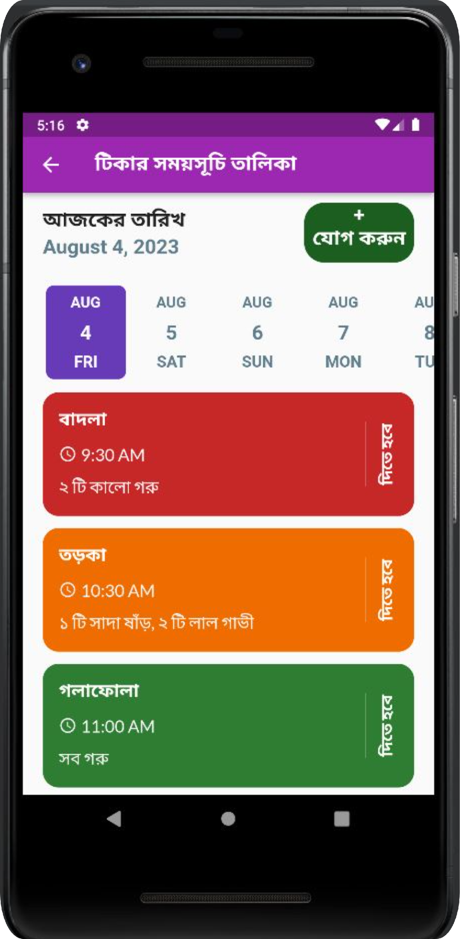
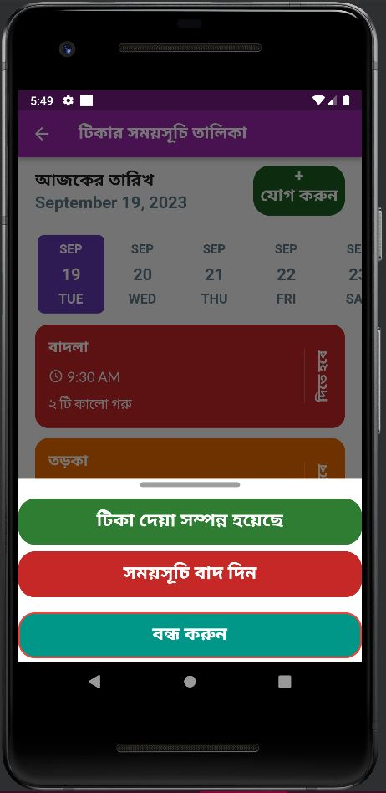
Vaccination Reminder
Not aware of providing vaccines to their cattle in time
Notified in time and won’t forget about the vaccination
29

Slide 31
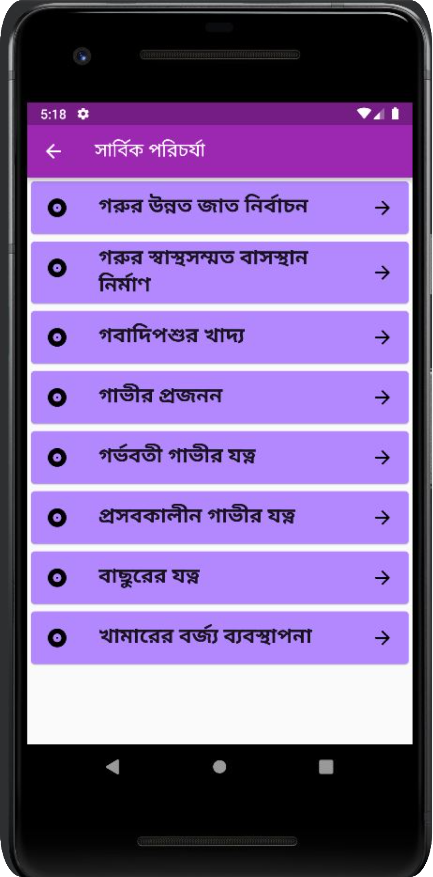
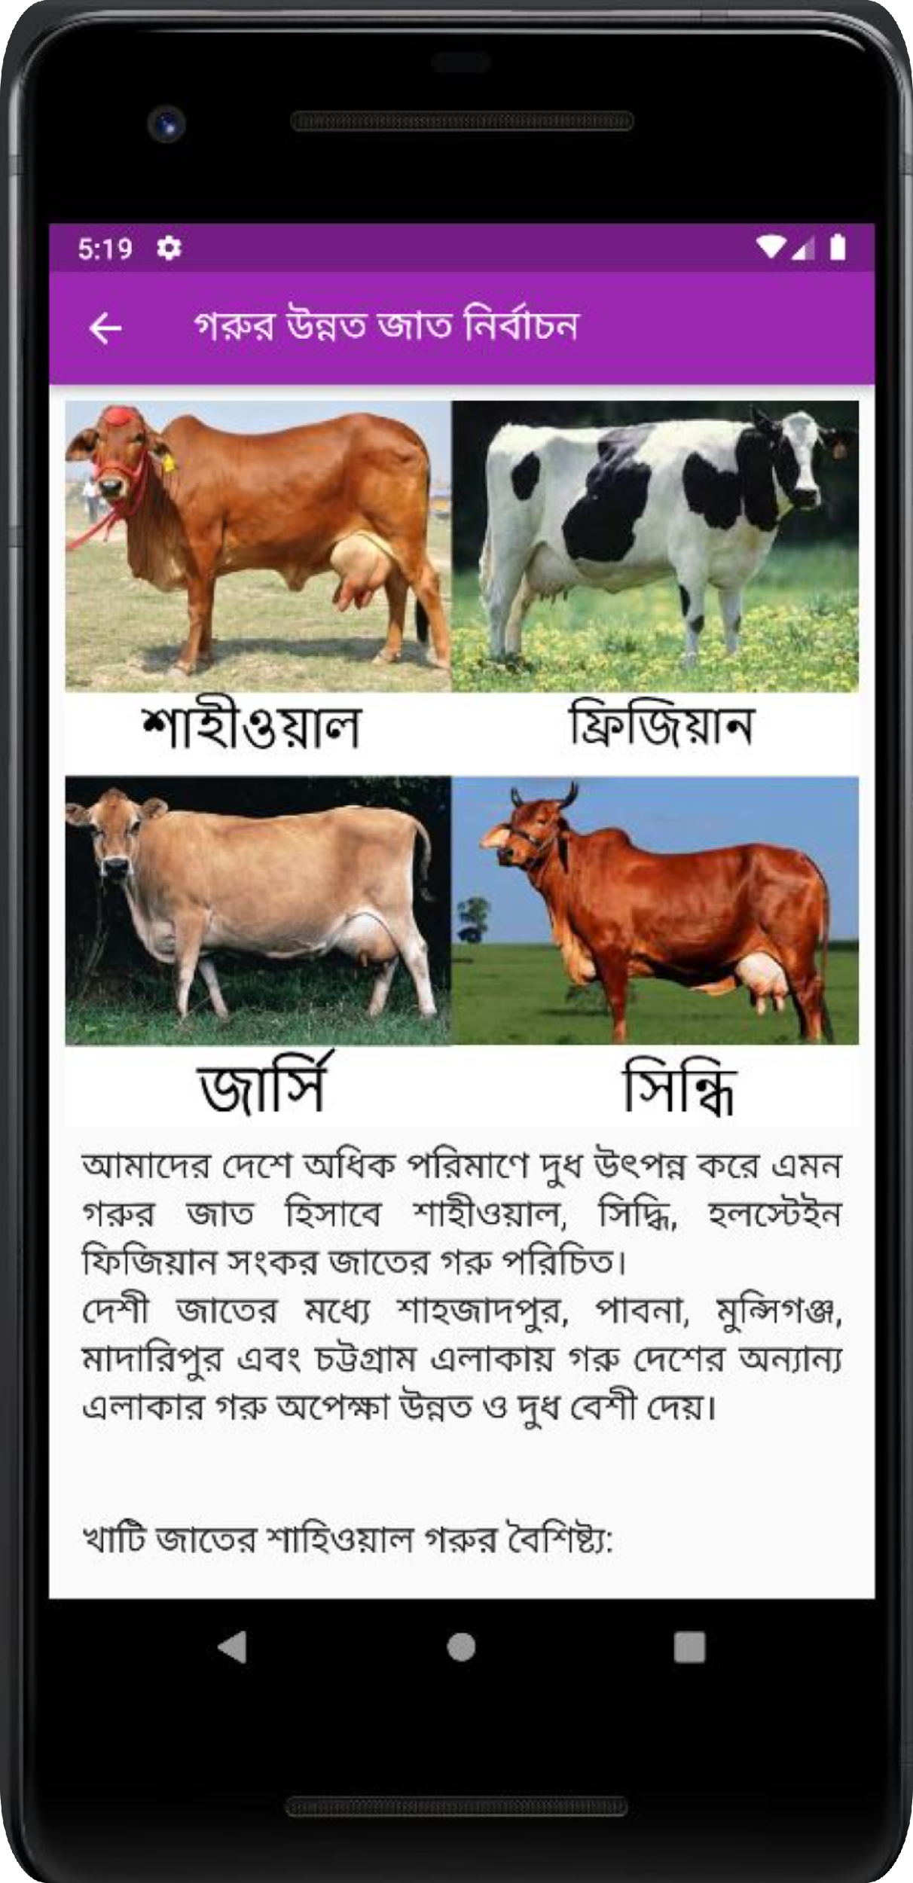
Cattle Grooming Guideline
Construct a perfect shelter
How to take care of pregnant cows
Types of food needed according to the age and breed
30

Slide 32
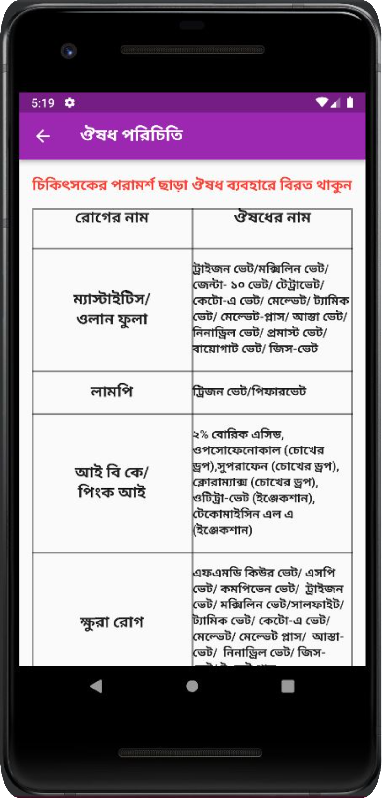
Generalization of Cattle Medicine
List of medicines for individual diseases
Know the correct medicine for a particular disease
31

Slide 33
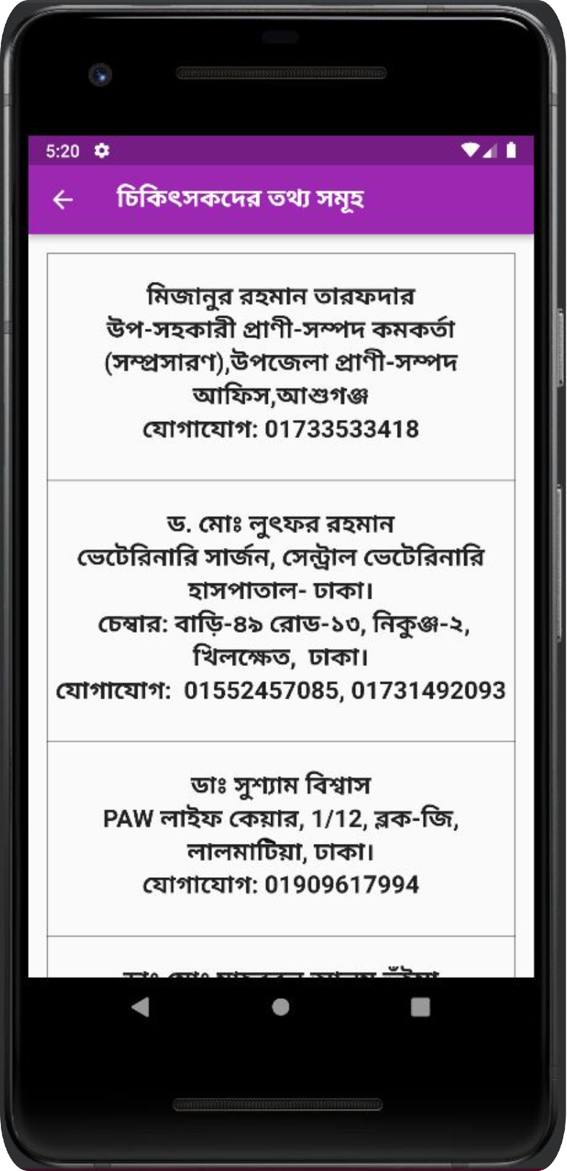
Veterinary Information
Information about veterinary doctors
Can contact with the veterinarians during any emergency or critical moments for the cattle
32

Slide 34
CattleSavior Application Demo
https://youtu.be/eZPQrS1kd94?si=O2eQPSGdYrxWA8Sb
33

Slide 35
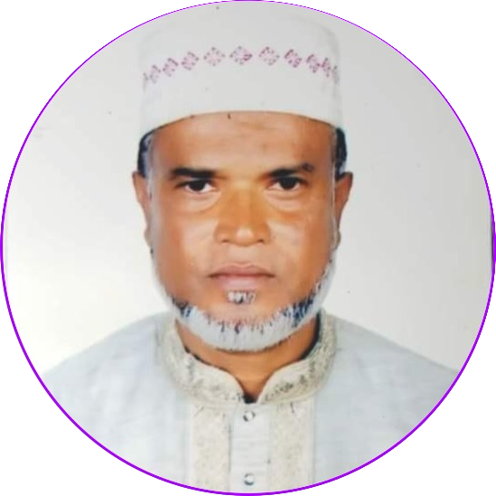
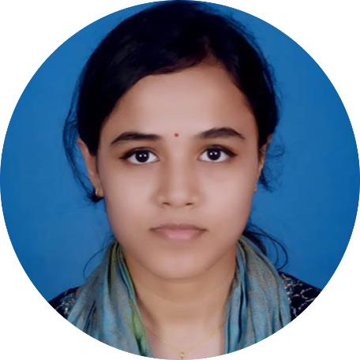
App Verification
CATTLESAVIOR
Verified
Dr. Mizanur Rahman Tarafder
Deputy Assistant livestock Officer
(Extension)
Upazila livestock Office, Ashuganj
Phone No. 01733533418
Dr. Rhituka Saha
Doctor of Veterinary Medicine (DVM)
Bangabandhu Sheikh Mujibur Rahman
Agricultural University(BSMRAU)
Reg no. 8348
Phone No. 01613625656
34

Slide 36
Final Survey User Feedback
CattleSavior
1
2
3
4
5
Return back to the Cattle Farmers
Live Demonstration of the App
Install the App for test use(15 days)
Collect User Feedback
Prepare a Questionnaire
35

Slide 37
SURVEY
QUESTIONNAIRE
DESIGN
Open-ended Questions
9.5%
2
Demographic Questions
47.6%
Likert Scale questions
42.9%
10
DEMOGRAPHIC
9
LIKERT SCALE
Name
Gender
Age
Number of Cattles
Educational Qualification
Contact Number
Smartphone Model
RAM
ROM
Smartphone Price
App usage
App smoothness
Accurate detection
Reduce economic loss
App information
Learning outcome
Recommend others
Feature reviews
Rating of the app
OPEN-ENDED
Any improvement for the existing features
Necessity of any other features
36

Slide 38
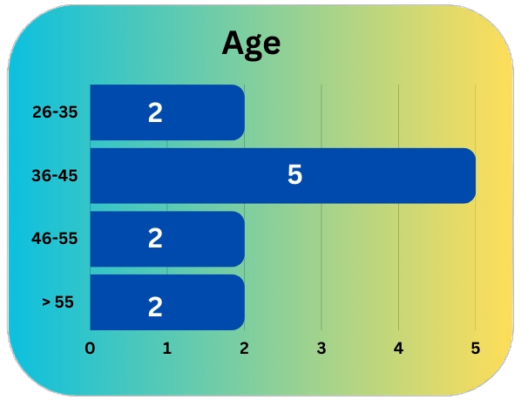
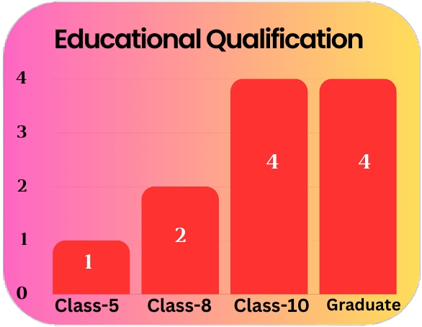
Survey Findings (Demography)
>> Bishmile
>> Pandhoa
>> Kamarpara
>> Bhatulia
>> Bamnartek
Area
Gender
Male - 10
Female - 1
Savar (5)
Uttara(6)
Number of Cattles
Total = 353
Average = 32
Smartphone Price
Users
RAM & ROM
<10000 BDT 0
10000 - 14999 2
15000 - 19999 4
20000 - 24999 1
25000 - 29999 4
Minimum = 4 GB/ 32 GB
Average = 4 GB/ 64 GB
37

Slide 39
Survey Findings (Likert Scale)
Questions | Answers | Likert Score avg.(out of 5)
Frequency of using the app | Often
Smooth running on device | Strongly Agree
Accurate Disease Detection | Strongly Agree
Reduce Economic Loss | Agree
Important Information | Agree
Learnt more about the Diseases | Agree
(3.90)
(4.72)
(4.63)
(4.45)
(4.45)
(4.18)
Recommend others | Very Likely
(4.72)
38

Slide 40
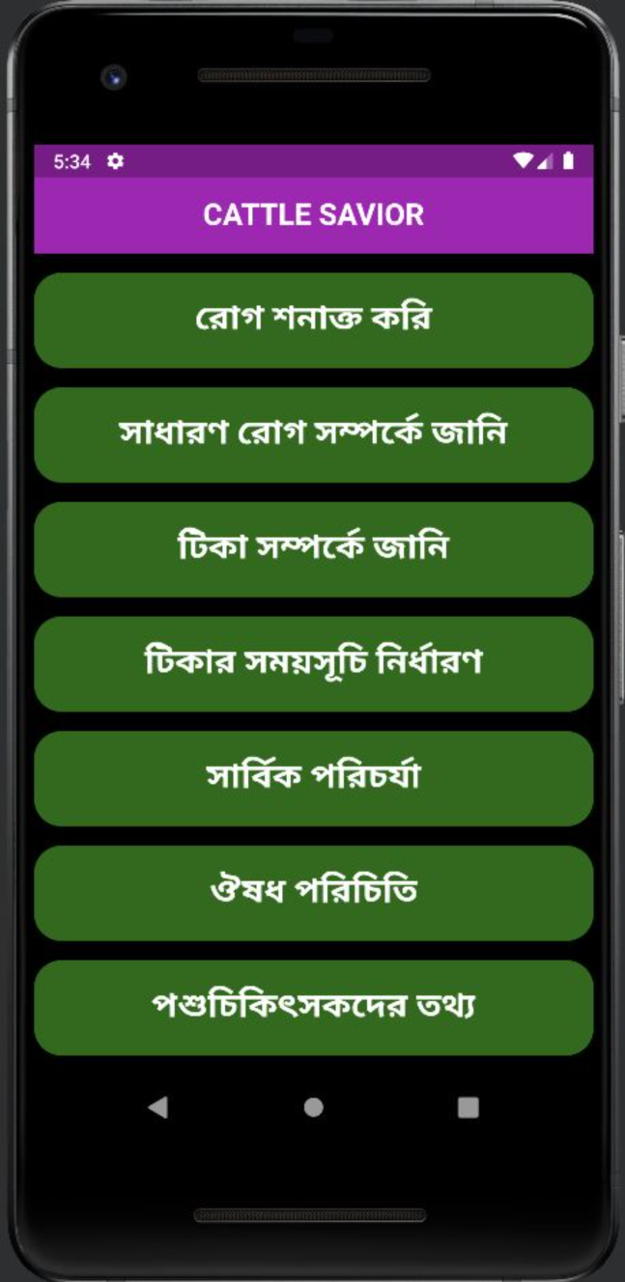
Rating of the Features
2
Disease Detection
General Disease Details
Rating - 4.63 (Very Good)
1
Instant Feedback
Rating - 4.63 (Very Good)
Rating - 4.09(Good)
3
Vaccine Reminder
Vaccination Information
Rating - 4.81 (Very Good)
4
Rating - 4.54 (Very Good)
Medicine List
6
Rating - 4.45 (Good)
5
Cattle Grooming Guidelines
Rating - 4.18(Good)
Veterinary Information
7
Rating - 4.54 (Very Good)
39

Slide 41
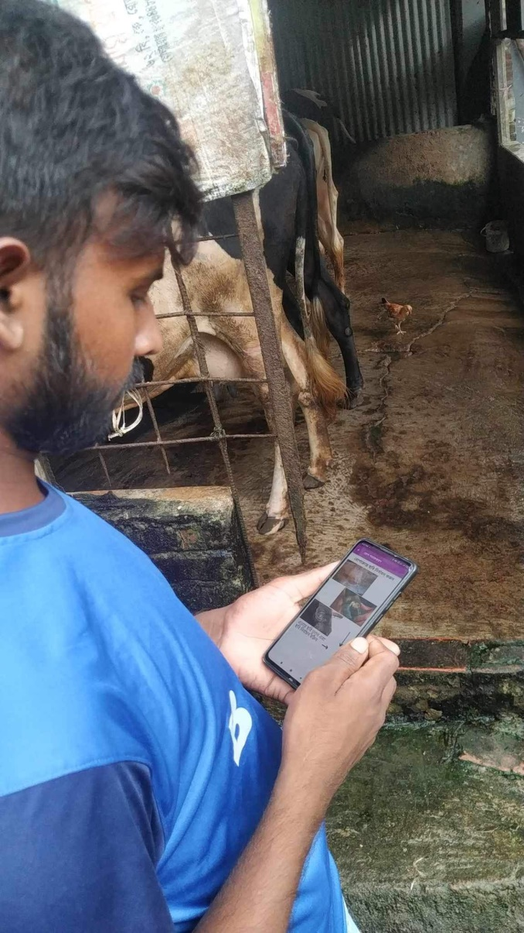

CattleSavior App Rating
(3)
(7)
(0)
(1)
(0)
Overall Rating = 4.09 (out of 5)
40

Slide 42
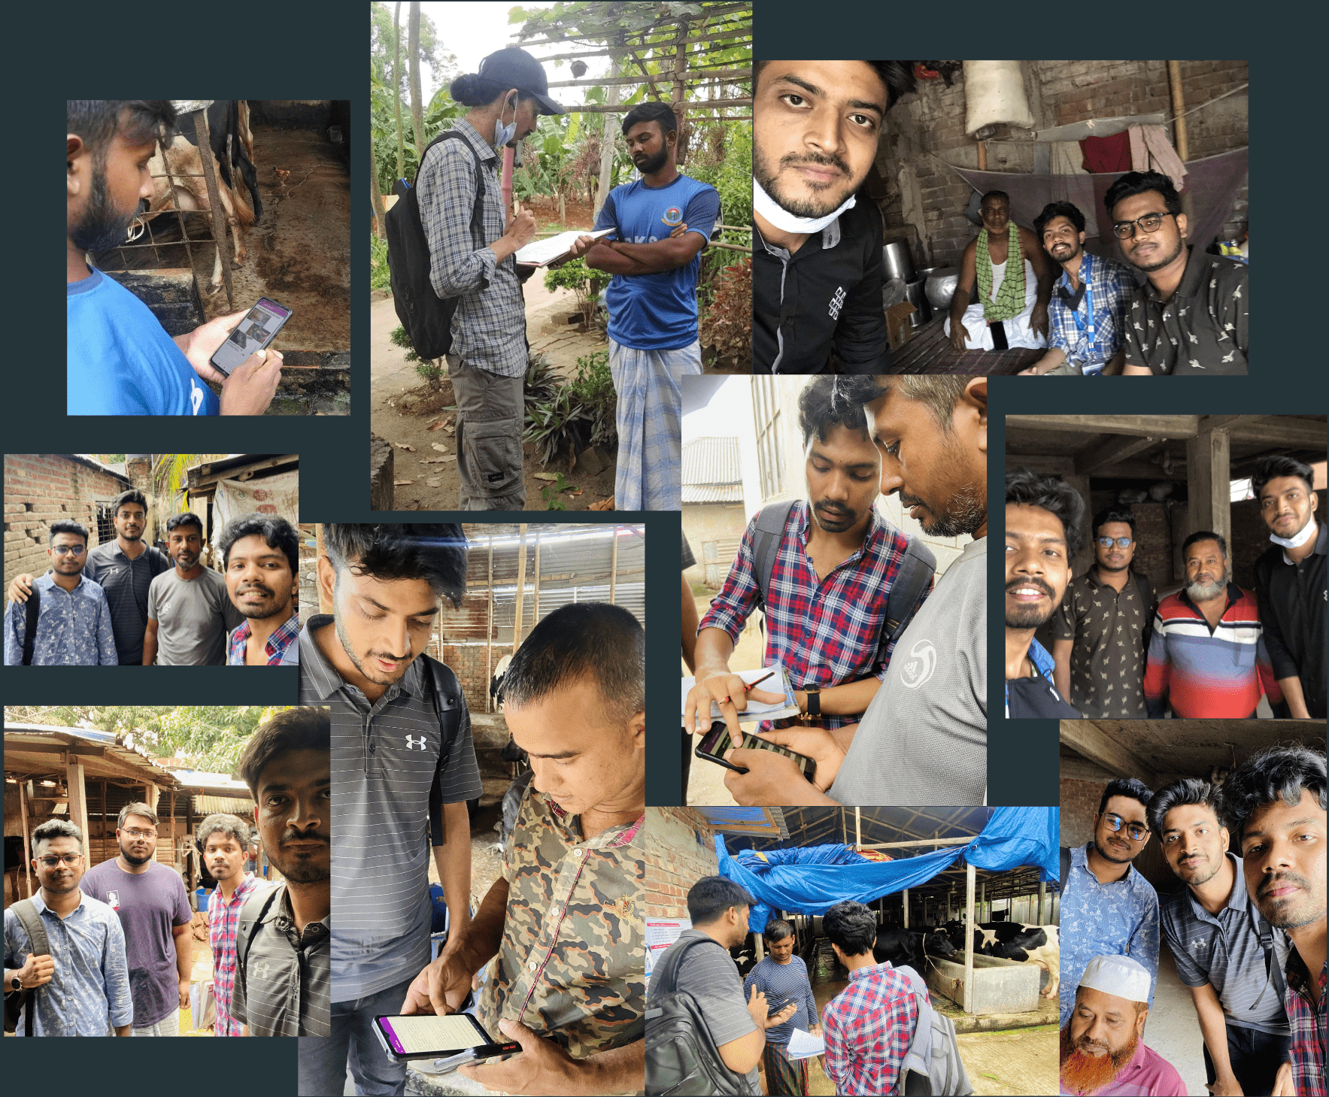
User Satisfaction
User Satisfaction Rate = 90.9%
10 out of 11 Cattle Farmers are satisfied
41

Slide 43
FUTURE WORK
Add more diseases for detection
Monitor and keep the App data up to date
CATTLESAVIOR
New Features:
Find the nearest Veterinary Hospital
Cattle Community
42

Slide 44
References
D. Sun, Role of livestock in our economy: Daily sun —. [Online]. Available: https://www.daily-sun.com/printversion/details/611300/Role-of-Livestockin-Our-Economy.
M. Genemo, “Detecting high-risk area for lumpy skin disease in cattle using deep learning feature,” Advances in Artificial Intelligence Research, vol. 3, no. 1, pp. 27–35, 2023.
M. Rony, D. Barai, M. Z. Hasan, et al., “Automated foot and mouth disease classification using transfer learning-based deep convolutional neural network,” pp. 1–6, 202
M. Rony, D. Barai, Z. Hasan, et al., “Cattle external disease classification using deep learning techniques,” pp. 1–7, 2021.
N. Shivaanivarsha, P. B. Lakshmidevi, and J. T. Josy, “A convnet based realtime detection and interpretation of bovine disorders,” pp. 1–6, 2022. doi: 10.1109/IC3IOT53935.2022.9767880.
R. Katamba and B. Mutebi, “Jaguza livestock app, the app transforming livestock production and strengthening food security,” in 2017 IST-Africa Week Conference (IST-Africa), IEEE, 2017, pp. 1–12.
43

Slide 45
Thank You.
Do you have any questions?

